Slide 1
Combinational and Sequential Circuits
Kirill Korolev
30 September 2019

Slide 2
Layers of Abstraction in Computer Science (CS)
Application
Algorithms
Programming Language
Operating System
Instruction Set Architecture
Microarchitecture
Gates/Register-Transfer Level (RTL)
Topics of
this lecture
Circuits
Physics

Slide 3
Boolean operations: Inversion
NOT (Inversion)
2 MOSFET
1
Vcc
x | !x
0 | 1
1 | 0
x
!x
x
Output
0

Slide 4
Boolean operations: AND & OR
AND (or Boolean multiplication)
NAND
OR (or Boolean addition)
NOR
x | y | x*y
0 | 0 | 0
0 | 1 | 0
1 | 0 | 0
1 | 1 | 1
x | y | x+y
0 | 0 | 0
0 | 1 | 1
1 | 0 | 1
1 | 1 | 1
x
x
x*y
x+y
y
y
4 MOSFET
4 MOSFET
Vcc
Vcc
1
1
A
B
Output
Output
x
A
x
!(x*y)
!(x+y)
y
B
y
0
0

Slide 5
Boolean functions
Boolean operations can be combined into functions
F(x,y,z) = x + !y*z
x
x + !y*z
x | y | z | F
0 | 0 | 0
0 | 0 | 1
0 | 1 | 0
0 | 1 | 1
1 | … | … | 1
y
0
z
1
0
0

Slide 6
Combinational Circuits

Slide 7
Combinational Circuits
If the output of a function is completely defined by the current input then the function is called combinational :
Qt = F(xt, yt, zt, …)
A lot of things can be implemented using combinational circuits
e. g. adder, decoder, multiplexer…

Slide 8
Adder

Slide 9
Half adder scheme
It is an adder …but not a full adder
No input carry
It is an adder, but it is not a full adder, because it does not have input carry
 |  | x⊕y | x*y
x | y | sum | carry
0 | 0 | 0 | 0
0 | 1 | 1 | 0
1 | 0 | 1 | 0
1 | 1 | 0 | 1
x
half +
sum
x
y
sum
y
carry
carry
sum = x⊕y = !x*y + x*!y
carry = x*y

Slide 10
Full adder scheme
We add input carry here
xn | yn | cn-1 | sn | cn
0 | 0 | 0 | 0 | 0
0 | 1 | 0 | 1 | 0
1 | 0 | 0 | 1 | 0
1 | 1 | 0 | 0 | 1
cn-1
cn-1
half +
xn
half +
+
sn
sn
xn
yn
yn
cn
0 | 0 | 1 | 1 | 0
0 | 1 | 1 | 0 | 1
1 | 0 | 1 | 0 | 1
1 | 1 | 1 | 1 | 1
It is called a full adder
Cn

Slide 11
Wide adder
We may add more adders to sum numbers wider than 1 bit
yn+1
xn+1
yn
xn
+
+
+
+
+
+
+
+
cn+1
cn
cn-1
sn+1
sn
In real HW, wide adders have more complicated schemes to avoid long “carry chains”

Slide 12
Subtraction

Slide 13
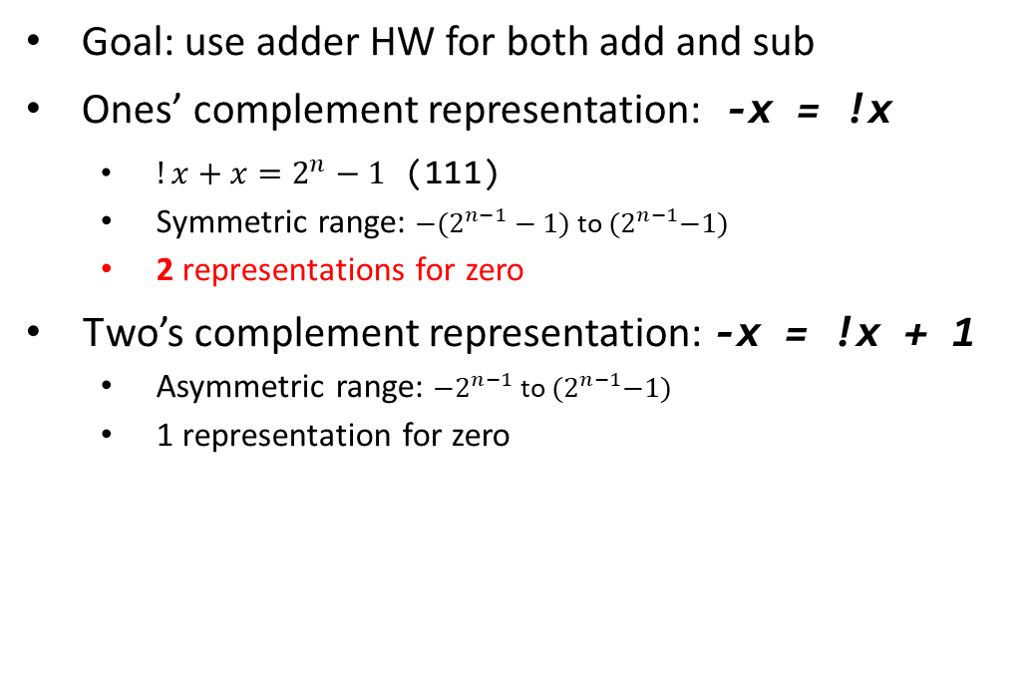
Representation of negative numbers
Goal: use adder HW for both add and sub
Ones’ complement representation: -x = !x
$!x+x=2^{n}−1$ (111)
Symmetric range: ${−(2}^{n−1}−1)$ to ${(2}^{n−1}−1)$
2 representations for zero
Two’s complement representation: -x = !x + 1
Asymmetric range: ${−2}^{n−1}$ to ${(2}^{n−1}−1)$
1 representation for zero
0
0
-1
000
+1
-0
111
001
-2
110
010
+2
+1
101
011
-3
100
+3
-2
-4

Slide 14
Example of subtraction
0
Example: 2 – 3 = ?
2 – 3 = 2 + (−3)
2 + (−3) = 010 + 101 = 111
111 = −1
-1
000
+1
111
001
-2
110
010
+2
0
-1
000
+1
101
011
+3
111
001
-3
100
-4
-2
110
010
+2
0
101
011
+3
-1
000
+1
-3
100
111
001
-4
-2
110
010
+2
101
011
+3
-3
100
-4

Slide 15
Overflow
Example: −2 – 3 = ?
−2 – 3 = −2 + (−3)
−2 + (−3) = 110 + 101 = 1011
011 = 3 → Overflow ☹
Overflow conditions
negative + negative = positive
positive + positive = negative
0
-1
000
+1
111
001
-2
110
010
+2
0
-1
000
+1
101
011
+3
111
001
-3
100
-4
-2
110
010
+2
0
101
011
+3
-1
000
+1
-3
100
111
001
-4
-2
110
010
+2
101
011
+3
-3
100
-4

Slide 16
Sequential Circuits

Slide 17
Sequential Circuits
If the output of a function depends not only on the current input, but on the previous state, then the function is called sequential
Main advantage - ability to remember the previous state
Used to store information
Qt = F(xt, yt, zt, …, Qt-1)
Qt = F(xt, yt, zt, …, Qt-1)
F(xt-1, yt-1, zt-1, …, Qt-2))
F(xt-2, yt-2, zt-2, …, Qt-3)))

Slide 18
SR Latch: Overview
The simplest store element:
SR latch:
SR latch:
reset
reset
Q
Q
S | R | Qt-1 | Qt
Q
0
1
0
1
0
0
Q
Q
!Q
0
1
Q
0
!Q
1
0
Q
1
1
!Q
0
1
0
set
set
1
1
Q
0
Prohibited state
0
1
NOR:
x
out
x
out
x | y | out
0 | 0 | 1
0 | 1 | 0
1 | 0 | 0
1 | 1 | 0
y
y
≡
≡
out
0
out
y

Slide 19
SR Latch: Timing
reset
Q
S | R | Qt-1 | Qt
0 | 0 | Q | Q
0 | 1 | Q | 0
1 | 0 | Q | 1
1 | 1 | Q | 0
R
Q
S
!Q
!Q
set
S
1
0
The output will be determined by the fastest signal
R
1
0
Q
1
But, which signal will be really faster will depend on many factors (e.g., temperature).
?
0
!Q
1
?
0

Slide 20
D Latch
Data
S
!Q
D
Q
D | we | Qt-1 | Qt
D | 0 | Q | Q
0 | 1 | Q | 0
1 | 1 | Q | 1
R
Q
we
Write enable
Don’t have prohibited states
Asserted by a level of the write enable signal (we)
Store one bit of information
Can be used as building block for creating static memory arrays

Slide 21
Single port 2^{M}xN Memory Array
Memory array has 3 input signals and 1 output
Data buses are N bits wide (each chunk is N bits)
Address is M bits wide if 2^{M} is array size
address
address
M
2
Write enable
Write enable
Memory
Array
Memory
Array
N
1
N
1
input data
input data
output data
output data

Slide 22
Next time – practice
More examples of combinational and sequential circuits
You will need the Logisim app:
Install Java: https://www.java.com/ru/download/
Download Ligisim: https://sourceforge.net/projects/circuit/

Slide 23
Thank You

Slide 24
Appendix

Slide 25
Critical paths

Slide 26
What is a critical path of scheme?
Critical path is the slowest logic path in the circuit
Reliable result of whole logic path can not be ready until critical path is passed by signal

Slide 27
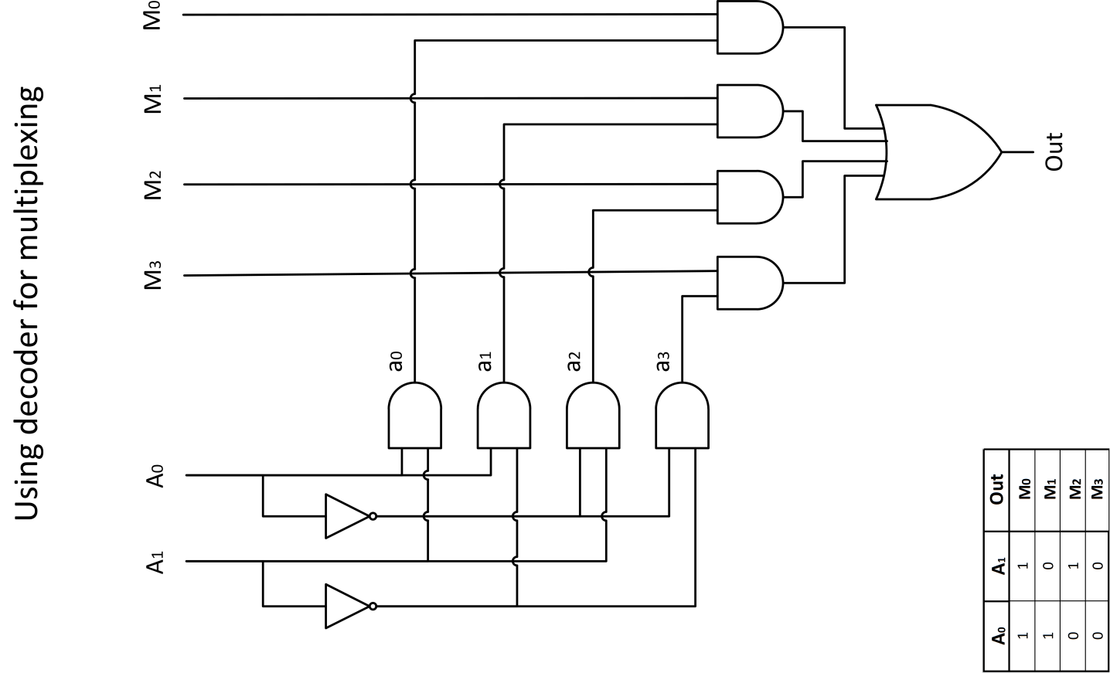
Example of critical path finding: Multiplexer
= 5t
1t
2t
1t
1t

